Slide 1

CSC- 362 Computer Networks Week-5 Lecture-9-10
Prepared by:
Mr. Attique Ur Rehman

Slide 2
Instructor Contact Details
Name: Mr. Attique Ur Rehman
Course Instructor: CSC362- Computer Networks
Credit Hours: (3+1)=4
Office Location: 2nd Floor Computer Science Faculty Office: 41-C
Email: attique.rehman@lgu.edu.pk
Visiting Hours: Wednesday (11:30 am -1:00 pm)

Slide 3
Course Material
Reference books
Many textbooks on Networking may be consulted
Research papers!
RFCs and Internet drafts
Related to TCP/IP suite and other protocols
Web resources
Tutorials, white papers, reports, etc.

Slide 4
Text Book
Computer Networks: A Systems Approach by Larry L. Peterson and Bruce S. Davies.
Third Edition [2003], Morgan Kaufmann Publishers, San Mateo, California, USA
Computer Networks by Andrew S. Tanenbaum
Fifth Edition
Data Communication and Computer Networks, by Behrouz A. Forouzan
5th Edition
Data and Computer Communications by William Stallings
10th Edition
Computer Networking: A Top-Down Approach Featuring the Internet by James F. Kurose and Keith W. Ross
6th edition

Slide 5
Reliable Transmission
Higher level of abstraction (transport layer vs. data link layer‏
my-machine
mail.yahoo.com
computer’s
is
my-machine
my
computer’s
name
is
my-machine
client
server

Slide 6
Reliable Transmission
Higher level of abstraction (transport layer vs. data link layer
computer’s my-machine
is
my
name
my-machine
mail.yahoo.com
my
computer’s
name
is
my-machine
client
server

Slide 7
Reliable Transmission
Error-correcting codes are not advanced enough to handle the range of bit and burst errors
Corrupt frames generally must be discarded
A reliable link-level protocol must recover from discarded frames
Goals for reliable transmission
Make channel appear reliable
Maintain packet order (usually)‏
Impose low overhead / allow full use of link

Slide 8
Reliable Transmission
Reliability accomplished using acknowledgments and timeouts
ACK is a small control frame confirming reception of an earlier frame
Having no ACK, sender retransmits after a timeout
Automatic Repeat reQuest (ARQ) algorithms
Stop-and-wait
Concurrent logical channels
Sliding window
Go-back-n, or selective repeat
Alternative: forward error correction (FEC)‏

Slide 9
Automatic Repeat reQuest
Acknowledgement (ACK)‏
Receiver tells sender when frame received
Cumulative ACK (used by TCP): have received specified frame and all previous
Selective ACK (SACK): specifies set of frames received
Negative ACK (NACK or NAK): receiver refuses to accept frame now, e. g. , when out of buffer space
Timeout: sender decides that frame was lost and tries again
ARQ is also called Positive Acknowledgement with Retransmission (PAR)‏

Slide 10
Stop-and-Wait
Send a single frame
Wait for ACK or timeout
If ACK received, continue with next frame
If timeout occurred, send again (and wait)‏
Frame lost in transit; or corrupted and discarded
Frame 0
Sender
ACK0
Receiver
Frame1
ACK1

Slide 11
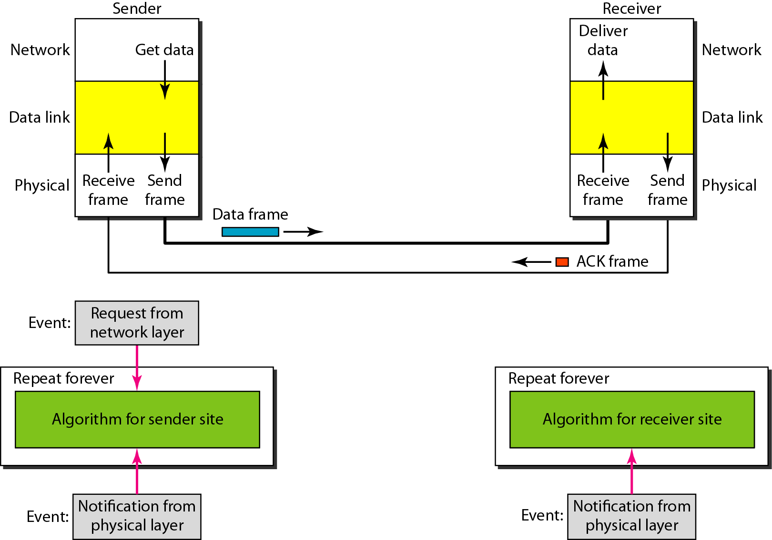
Design of Stop-and-Wait Protocol

Slide 12
Acknowledgments and Timeouts

Slide 13
Stop-and-Wait ARQ
If receiver receives a frame correctly, but sender receives the ACK after timeout …
Sender resends the frame; how the receiver knows it’s the same frame or the next frame ?
Requires frame identification
Duplicate frame ?
Duplicate ACK ?
1 bit is enough (if physical network maintains order)‏
sender tracks frame ID to send
receiver tracks next frame ID expected

Slide 14
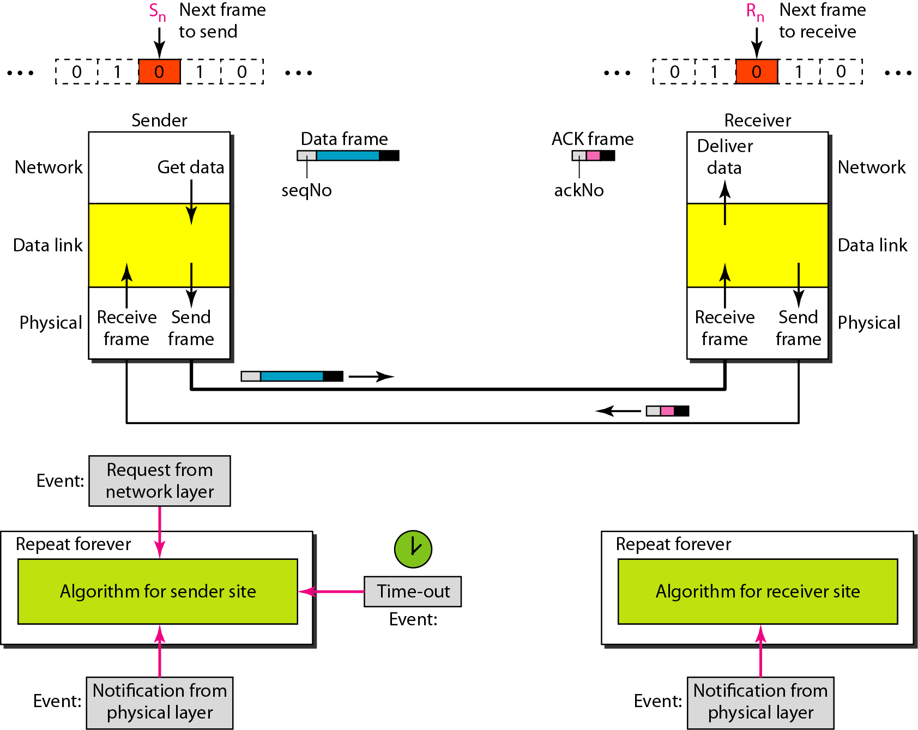
Design of the Stop-and-Wait ARQ Protocol

Slide 15
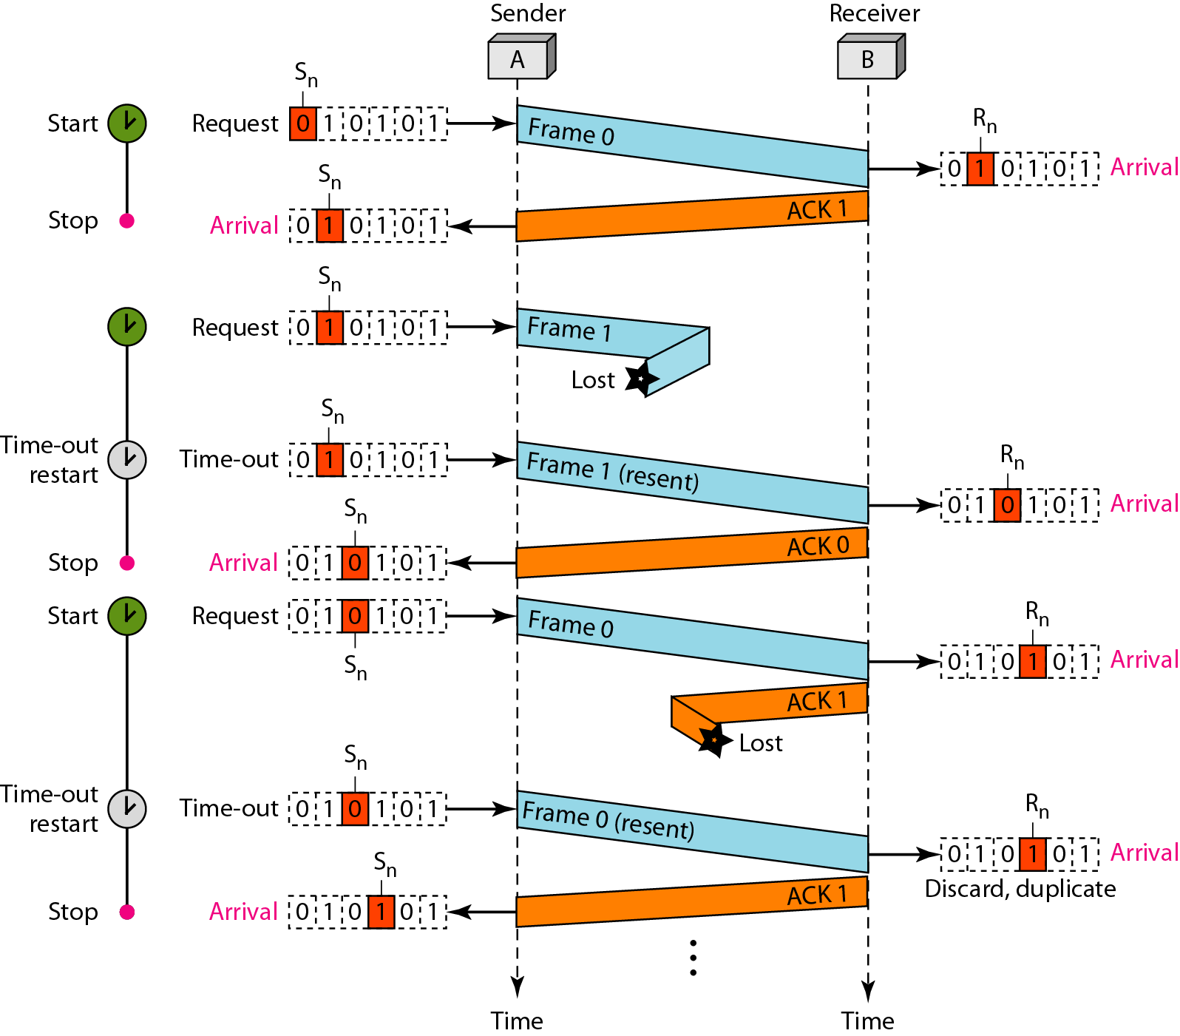
Example: Stop-and-Wait ARQ

Slide 16
Stop-and-Wait ARQ State Diagram
receive
frame 0
send: 0
expect: 0
send: 0
expect: 1
receive frame 0 /
receive ACK 1
receive
ACK 1
receive
ACK 0
send: 1
expect: 0
send: 1
expect: 1
receive
frame 1

Slide 17
Efficiency of Stop-and-Wait ARQ
Assume that, in a Stop-and-Wait ARQ system, the bandwidth of the line is 1 Mbps, and 1 bit takes 20 ms to make a round trip. What is the bandwidth-delay product? If the system data frames are 1000 bits in length, what is the utilization percentage of the link?
Bandwidth Delay Product
The system can send 20,000 bits during the time it takes for the data to go from the sender to the receiver and then back again.

Slide 18
Efficiency of Stop-and-Wait ARQ
However, the system sends only 1000 bits. We can say that the link utilization is only 1000/20,000, or 5 percent. Bandwidth Delay Product.
What is the utilization percentage of the link in above example if we have a protocol that can send up to 15 frames before stopping and worrying about the acknowledgments?
The system can send up to 15 frames or 15,000 bits during a round trip. This means the utilization is 15,000/20,000, or 75 percent.

Slide 19
Stop-and-Wait ARQ
Frames delivered reliably and in order
Is that enough ?
No, we need performance, too.
Problem: keeping the pipe full … ?
Example
1.5Mbps link x 45ms RTT = 67.5Kb (~8KB)‏
1KB frames implies 1KB/45ms= 182 Kbps (1/8th link utilization)‏
Want the sender to transmit 8 frames before waiting for ACK
Throughput remains 182 Kbps regardless of the link bandwidth !!

Slide 20

Concurrent Logical Channels
Multiplex several logical channels over a single p-to-p physical link (include channel ID in header)‏
Use stop-and-wait for each logical channel
Maintain three bits of state for each logical channel:
Boolean saying whether the channel is currently busy
Sequence number for frames sent on this channel
Next sequence number to expect on this channel

Slide 21
Concurrent Logical Channels
Header for each frame include 3-bit channel number and 1-bit sequence number
Same number of bits (4) as the sliding window requires to support up to 8 outstanding frames on the link
Characteristics
Separates reliability from flow control and frame order
Each channel limited by stop-and-wait bandwidth
Aggregate bandwidth uses full physical link
Supports multiple communicating processes
Can use more than one channel per process
But no frame ordering between channels

Slide 22
Approaches for Reliable Transmission …
Stop-and-wait
Provides reliable, in-order delivery
Sacrifices performance
Multiple logical channels
Provides reliable delivery at full link bandwidth
Sacrifices packet ordering
Sliding window: meets all three goals

Slide 23
Sliding Window
Allow sender to transmit multiple frames before receiving an ACK, thereby keeping the pipe full
Upper bound on outstanding un-ACKed frames
Also used at the transport layer (by TCP)‏
Sender
…
Receiver
ime
T
…

Slide 24
Sliding Window Concepts
Consider ordered stream of data
broken into frames
stop-and-wait
window of one frame
slides along stream over time
Sliding window algorithms generalize this notion
multiple-frame send window
multiple-frame receive window
time

Slide 25
Sliding Window Concepts
Send window
fixed length, containing numbered frames
starts at earliest unacknowledged frame
only frames in window sent over network
Green: sent and acknowledged
Red: sent (or can be sent) but not acknowledged
Blue: available, but not within send window
time

Slide 26
Sliding Window Concepts
Receive window
fixed length (unrelated to send window)‏
starts at earliest unreceived frame
only frames in window are buffered
Green: received and delivered
Red: received and buffered
Blue: received and discarded
time

Slide 27
Sliding Window - Sender
Assign sequence number to each frame (SeqNum)‏
Maintain three state variables:
send window size (SWS)‏
last acknowledgment received (LAR)‏
last frame sent (LFS)‏
Maintain invariant: LFS - LAR ≤ SWS
Advance LAR when ACK arrives
Buffer up to SWS frames and associate timeouts
LAR=13
≤ SWS
LFS=18
time
11
12
13
14
15
16
17
18
19
20

Slide 28
Sliding Window - Receiver
Maintain three state variables
receive window size (RWS)‏
largest acceptable frame (LAF)‏
last frame received (LFR) or next frame expected (NFE)‏
Maintain invariant: LAF – LFR ≤ RWS
Frame SeqNum arrives:
if LFR ≤ SeqNum ≤ LAF → accept
if SeqNum ≤ LFR or SeqNum > LAF → discarded
Send cumulative ACKs
≤ RWS
time
LFR=12
LAF=17
11
12
13
14
15
16
17
18
19
20

Slide 29
Sliding Window Issues
When a timeout occurs, data in transit decreases
Pipe is no longer full when packet losses occur
Problem aggravates with delay in packet loss detection
Early detection of packet losses improves performance:
Negative Acknowledgements (NACKs)‏
Duplicate Acknowledgements
Selective Acknowledgements (SACKs)‏
Adds complexity but helps keeping the pipe full

Slide 30
Sliding Window Classification
Stop-and-wait: SWS=1, RWS=1
Go-back-N: SWS=N, RWS=1
Selective repeat: SWS=N, RWS=M (usually M = N)‏
stop-and-wait
go-back-N
selective repeat

Slide 31
Sliding Window: Go-back-N
Go-back-N (SWS=N, RWS=1)‏
Receiver only buffers 1 frame
If frame lost, sender may need to resend N frames
i. e. , sender goes back N frames
Variations
How long is the frame timeout?
Does receiver send NACK for out-of-sequence frame?
Inefficient for a noisy link

Slide 32
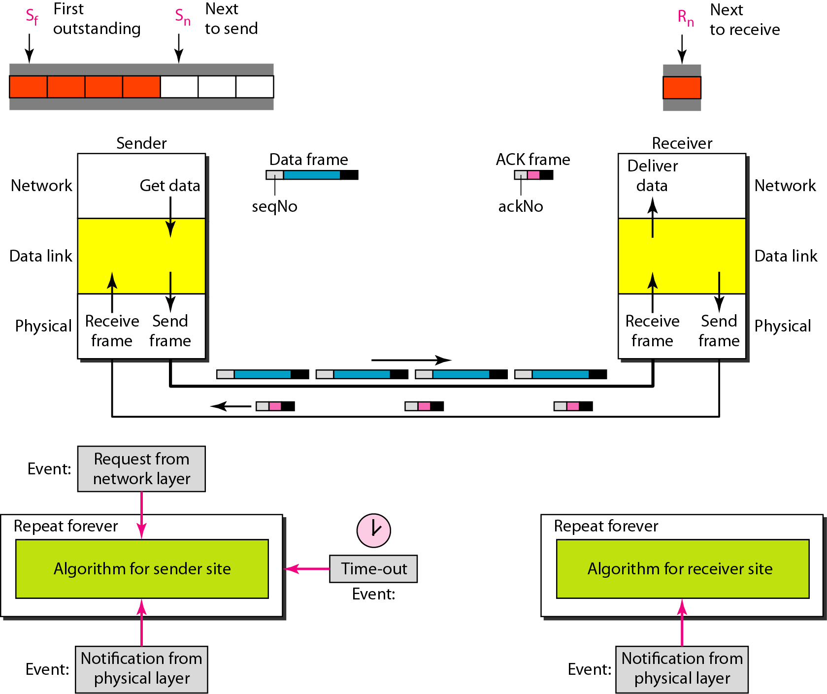
Sliding Window: Go-back-N

Slide 33
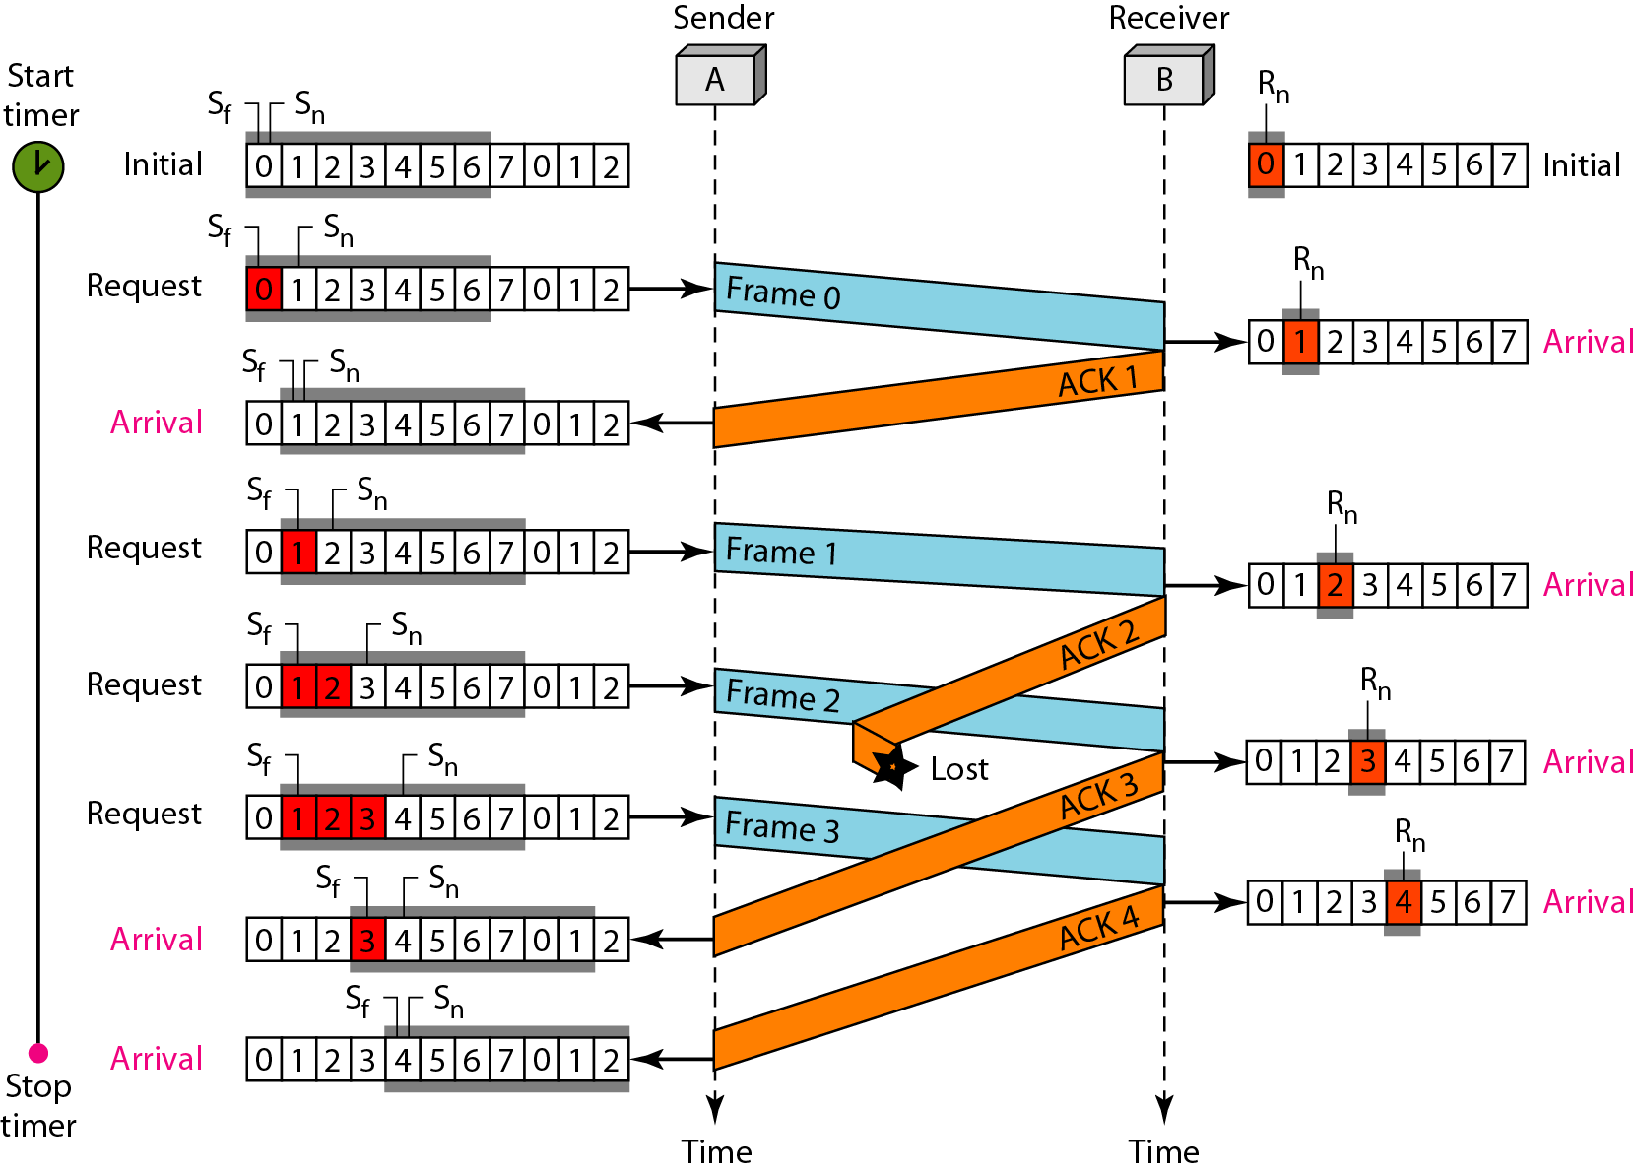
Sliding Window: Go-back-N
Cumulative acknowledgments: Note that although ACK 2 is lost, ACK 3 serves as both ACK 2 and ACK 3

Slide 34
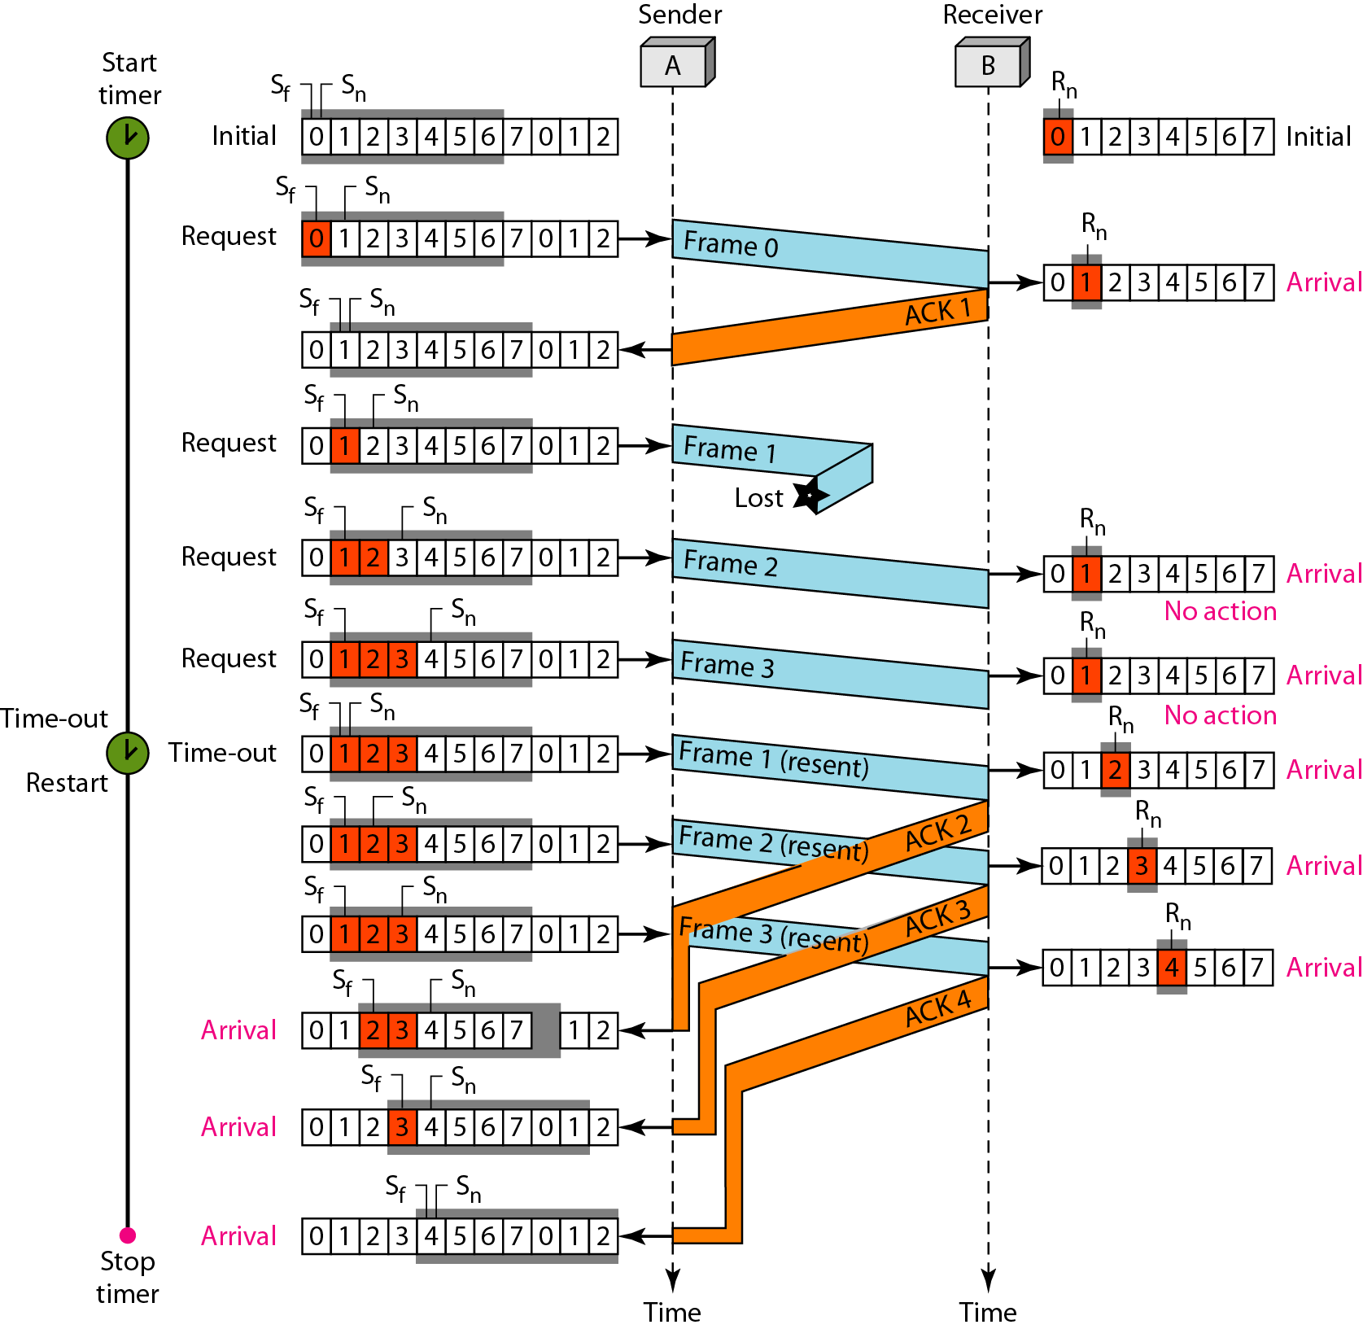
Sliding Window: Go-back-N
Time Out: Note that before the second timer expires, all outstanding frames have been sent and the timer is stopped.

Slide 35
Sliding Window: Selective Repeat
Selective repeat (SWS=N, RWS=M)‏
Receiver buffers M frames
If frame lost, sender must resend only
frames lost within receive window
frames past end of receive window
Variations
How long is the frame timeout?
Use cumulative or per-frame ACK?
Does protocol adapt timeouts?
Does protocol adapt SWS and/or RWS?

Slide 36
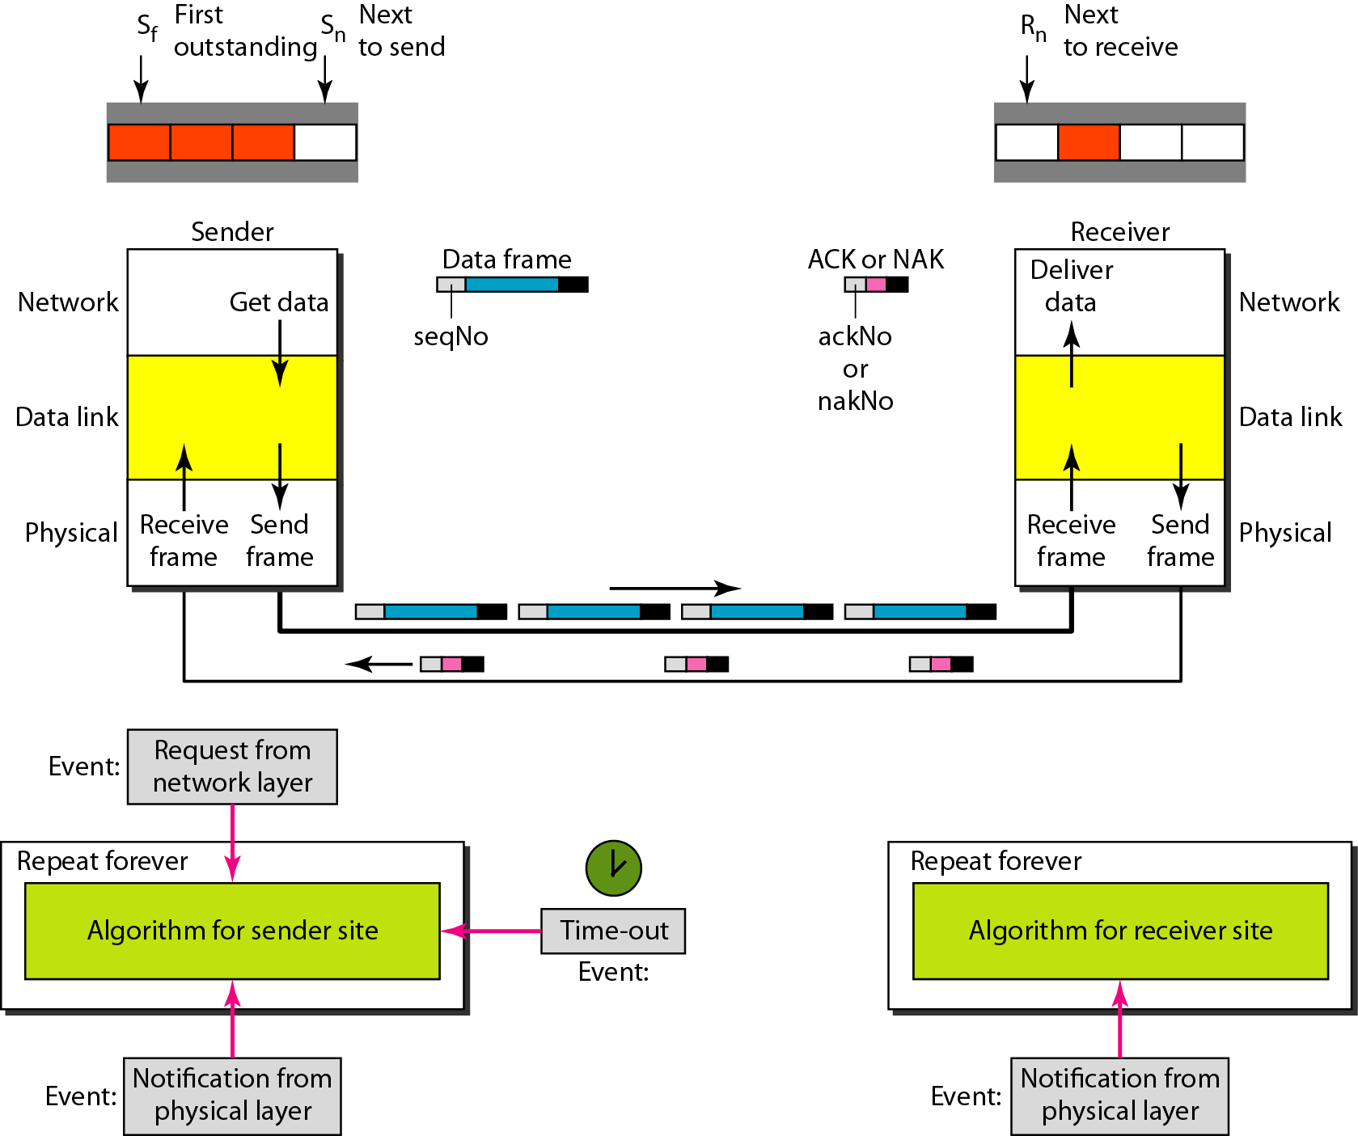
Sliding Window: Selective Repeat

Slide 37
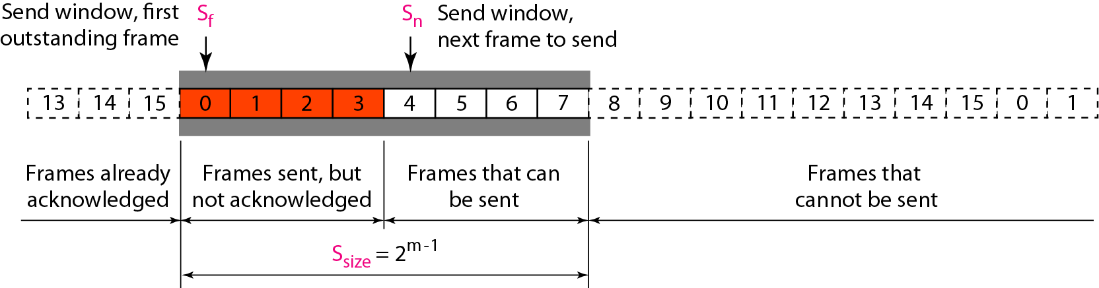
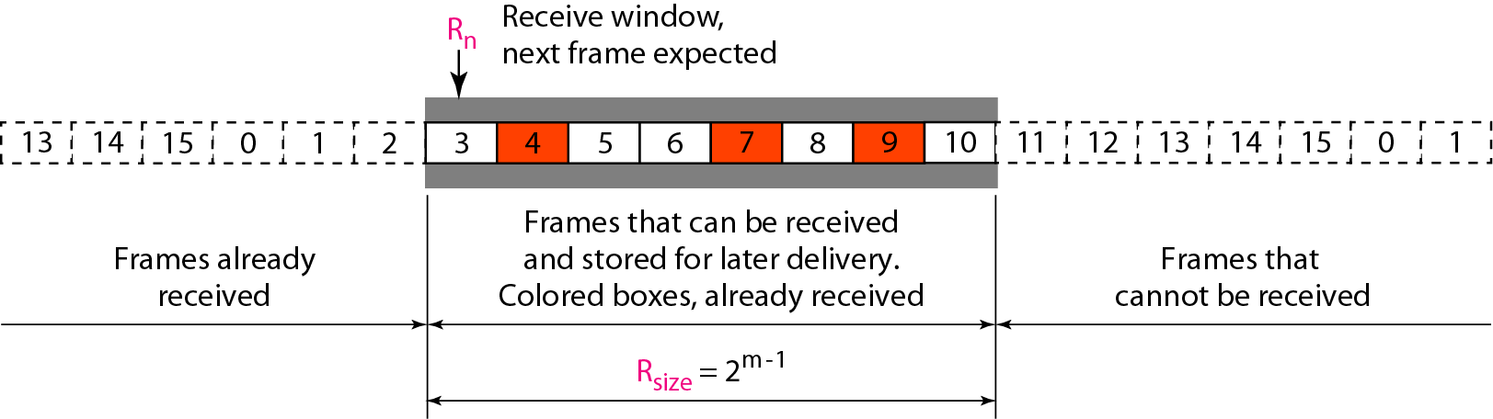
Sliding Window: Selective Repeat
Sender
Receiver

Slide 38
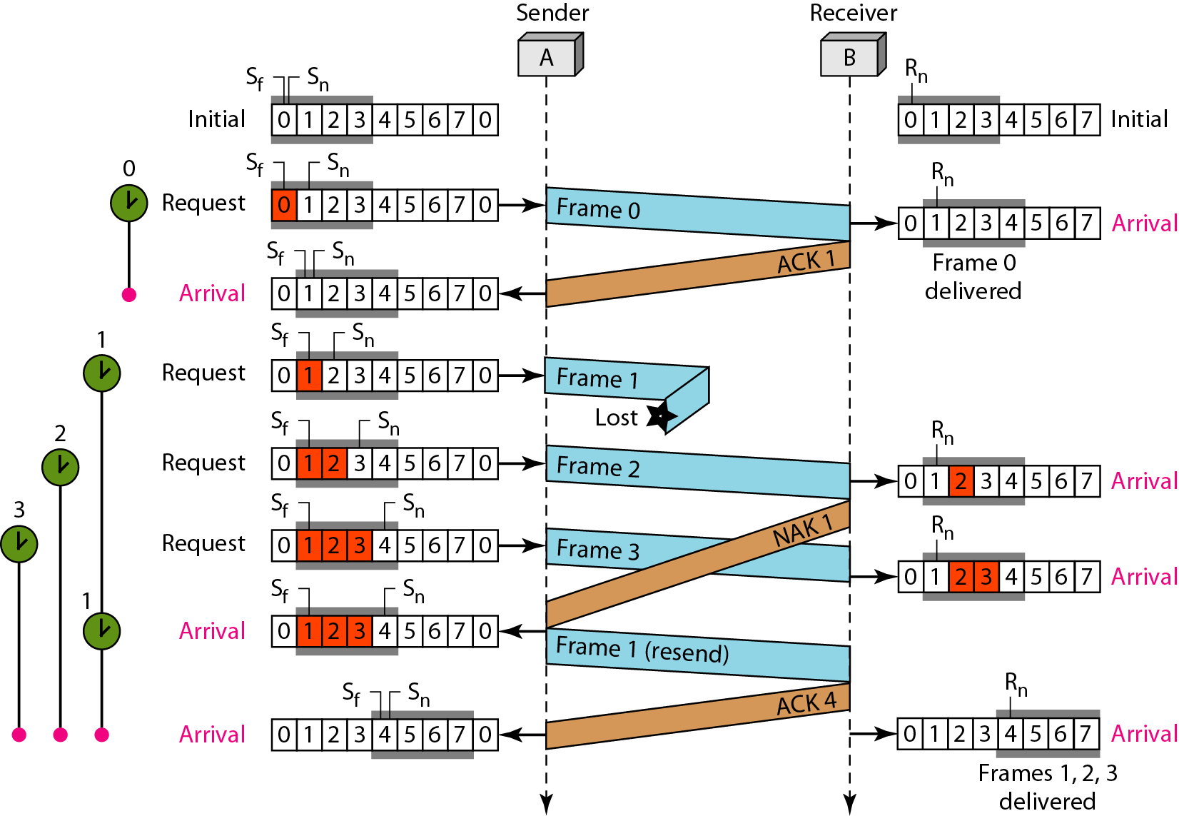
Sliding Window: Selective Repeat

